Slide 1

CSC- 362 Computer Networks Week-4 Lecture- 7-8
Prepared by:
Mr. Attique Ur Rehman

Slide 2
Instructor Contact Details
Name: Mr. Attique Ur Rehman
Course Instructor: CSC362- Computer Networks
Credit Hours: (3+1)=4
Office Location: 2nd Floor Computer Science Faculty Office: 41-C
Email: attique.rehman@lgu.edu.pk
Visiting Hours: Wednesday (11:30 am -1:00 pm)

Slide 3
Course Material
Reference books
Many textbooks on Networking may be consulted
Research papers!
RFCs and Internet drafts
Related to TCP/IP suite and other protocols
Web resources
Tutorials, white papers, reports, etc.

Slide 4
Text Book
Computer Networks: A Systems Approach by Larry L. Peterson and Bruce S. Davies.
Third Edition [2003], Morgan Kaufmann Publishers, San Mateo, California, USA
Computer Networks by Andrew S. Tanenbaum
Fifth Edition
Data Communication and Computer Networks, by Behrouz A. Forouzan
5th Edition
Data and Computer Communications by William Stallings
10th Edition
Computer Networking: A Top-Down Approach Featuring the Internet by James F. Kurose and Keith W. Ross
6th edition

Slide 5
Error Detection or Correction ?
Data can corrupted during transmission
Some applications require that errors be detected and corrected.
Detection implies discarding message and waiting for retransmission
uses bandwidth
introduces latency
Error correction requires more redundant bits to send all the time : error-correcting code (FEC)‏
Error correction is useful when:
errors are quite probable (wireless links)‏
retransmission cost is too high (latency in satellite link, multicast)‏

Slide 6
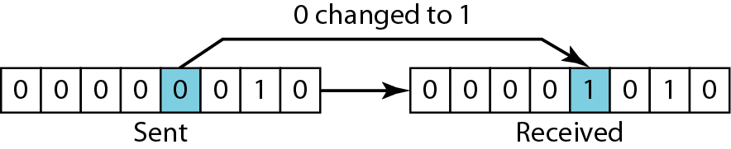
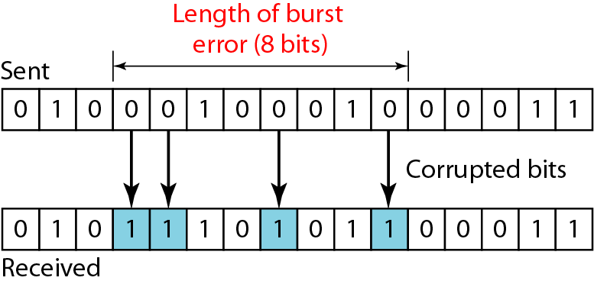
Types of Error
Single bit error
only 1 bit in the data unit has changed.
Burst Error
2 or more bits in data units have changed

Slide 7
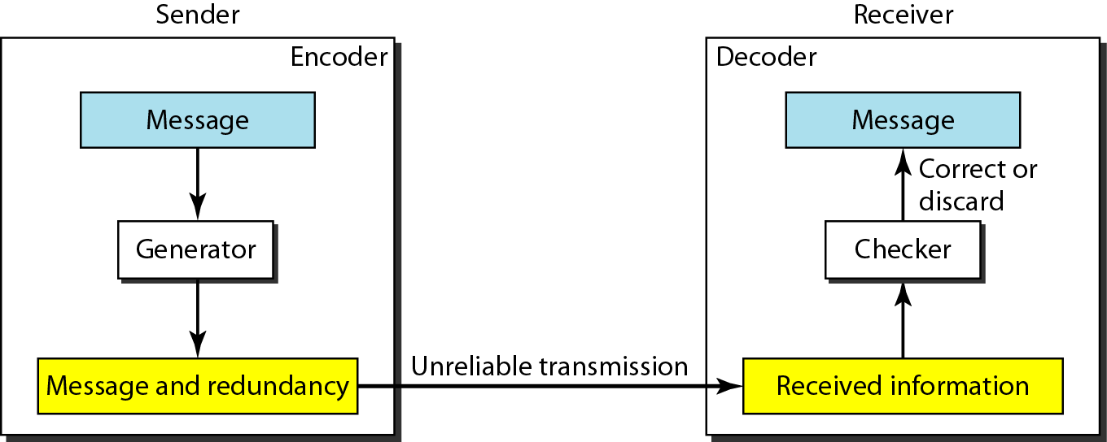
Error Detection or Correction: Structure of Sender and Receiver
To detect or correct errors, we need to send extra (redundant) bits with data.

Slide 8
Error Detection
Why we need it ?
To avoid retransmission of whole packet or message
What to do if error detected ?
Discard, and request a new copy of the frame:
explicitly or implicitly
Try to correct error, if possible

Slide 9
Error Detection
Validates correctness of each frame
Errors checked at many levels
Demodulation of signals into symbols (analog)‏
Bit error detection/correction (digital)—our main focus
Within network adapter (CRC check)‏
Within IP layer (IP checksum)‏
Possibly within application as well

Slide 10
Error Detection: How ?
How to detect error ?
Add redundant information to a frame to determine errors
Transmit two complete copies of data
n redundant bits for n-bit message
Error at the same position in two copies go undetected

Slide 11
Error Detection: How ?
We want only k redundant bits for an n-bit message, where k < < n
In Ethernet, 32-bit CRC for 12,000 bits (1500 bytes)‏
k bits are derived from the original message
Both the sender and receiver know the algorithm

Slide 12
Error Correction
Error-correcting codes try to add enough redundant information so that the receiver can still figure out the data if the frame is damaged. This is sometimes referred to as forward error correction.
The overhead is high but it reduces the need to resend frames.
These redundant codes are best suited for networks with high error (wireless).
Notes:
12

Slide 13
Hamming Distance
The Hamming distance between two words is the number of differences between corresponding bits.
To find hamming distance between two words just XOR them and then count the number of 1 bits in the result.
The Hamming distance d(000, 011) is 2 because
The Hamming distance d(10101, 11110) is 3 because
Notes:
13

Slide 14
Hamming Distance
110011000011001
010111001011001
-------------------------
100100001000000
The Hamming Distance is 3.
This means 3 bits would have to “flip” before we would be unable to detect an error.
The minimum Hamming distance is the smallest Hamming distance between all possible pairs in a set of words.
Notes:
14

Slide 15
Codewords
We do not make use of all of the possible codewords due to the use of check bits.
This means we can compute all of the legal codewords and determine the minimum Hamming distance for the set.
In order to detect d errors, we need a distance of d+1.
In order to correct d errors, we need a distance of 2d+1.
Notes:
15

Slide 16
The Parity Bit
Consider the parity bit that tells us if the parity of the data is even or odd.
The Hamming Distance would equal 2.
Since it is only one bit, then it is able to identify single errors (if one bit has flipped).
If two bits have flipped, then the parity bit will report the correct parity for the data.
Notes:
16

Slide 17
1-bit Error Detection with Parity
Every code has even number of 1’s
011
111
01
11
010
110
00
10
000
Valid codes
100
001
101
Parity encoding: gray dots are invalid and indicate errors
if only 1 bit flips, it can be detected

Slide 18
1-bit Error Correction with Voting
Every code is copied three times
011
111
0
1
010
110
Valid codes
000
100
- if only 1 bit flips, it can be corrected
- even with 2 erasures, bit can be recovered
001
101
gray dots correct to “1” blue dots correct to “0”

Slide 19
Error Bits or Error Burst
Common model of errors
Probability of error per bit
Error in each bit independent of others
Value of incorrect bit independent of others
Burst model
Probability of back-to-back bit errors
Error probability dependent on adjacent bits
Value of errors may have structure
Why assume bursts?
Appropriate for some media (e.g., Radio)‏
Faster signaling rate enhances such phenomena

Slide 20
Digital Error Detection Techniques
Two-dimensional parity
Detects up to 3-bit errors
Good for burst errors
Cyclic redundancy check (CRC)‏
Powerful mathematics
Tricky in software, simple in hardware
Used in network adapter

Slide 21
Two-Dimensional Parity
Parity
Adding one extra bit to a 7-bit code to balance 1s
extra parity byte for the entire frame
Catches all 1-, 2- and 3-bit errors and most 4-bit errors
14 redundant bits for a 42-bit message, in the example
bits
0101001
1
1101001
0
1011110
1
Data
0001110
1
0110100
1
1011111
0
Parity
1111011
0
byte

Slide 22
Two-Dimensional Parity
0
1
0
0
0
1
1
1
0
1
1
0
0
0
0
0
1
1
1
1
0
1
1
0
1
1
1
1
0
1
1
0
0
0
0
0
1
0
0
1
0
0
1
1
0
1
1
0
1
1
0
0
1
1
0
1
1
0
1
1
0
0

Slide 23
Cyclic Redundancy Check
Theory
based on finite-field (binary-valued) arithmetic
bit string represented as polynomial
coefficients are binary-valued
divide bit string polynomial by generator polynomial to generate CRC
Practice
bitwise XOR’s

Slide 24
Cyclic Redundancy Check
Add k bits of redundant data to an n-bit message
want k << n
e.g., k = 32 and n = 12,000 (1500 bytes)‏
Represent n-bit message as n-1 degree polynomial
e.g., MSG=10011010 as M(x) = x⁷ + x⁴ + x³ + x¹
Sender and receiver exchange polynomials
Let k be the degree of some agreed-upon divisor/ generator polynomial
e.g., C(x) = x³ + x² + 1

Slide 25
Cyclic Redundancy Check
Transmit polynomial P(x) that is evenly divisible by C(x)
shift left k bits, i.e., M(x)x^{k}
add remainder of M(x)x^{k} / C(x) into M(x)x^{k}
Receiver receives polynomial P(x) + E(x)‏
E(x) = 0 implies no errors
Receiver divides (P(x) + E(x)) by C(x); remainder will be zero ONLY if:
E(x) was zero (no error), or
E(x) is exactly divisible by C(x)‏

Slide 26
CRC Example - Sender
C(x) = x³+x²+1 = 1101 → generator
M(x) = x⁸ + x⁶ + x⁵ + x⁴+1 = 101110001 → message
1101 ) 101110001000
1101
1101
1101
00001000
1101
101 remainder
k bits

Slide 27
CRC Example - Receiver
C(x) = x³+x²+1 = 1101 → generator
M(x) = x¹¹+x⁹+x⁸+x⁷+x³+x²+1 = 101110001101 → message
1101 ) 101110001101
1101
1101
1101
00001101
1101
0 correct !
remainder bits

Slide 28
CRC Example - Receiver
C(x) = x³+x²+1 = 1101 → generator
M(x) = x¹¹+x⁹+x⁸+x⁷+x³+x²+1 = 101110001101 → message
1101 ) 101101001101
1101
1100
1101
1100
1101
1110
1101
111 incorrect !
Two bits are flipped

Slide 29
CRC Example - Receiver
C(x) = x³+x²+1 = 1101 → generator
M(x) = x¹¹+x⁹+x⁸+x⁷+x³+x²+1 = 101110001101 → message
1101 ) 101101011101
1101
1100
1101
1101
1101
1101
1101
0 incorrectly correct !!!
Three bits are flipped

Slide 30
Hamming Distance (1950 Paper)‏
Minimum number of bit flips between code words
2 flips for parity
3 flips for voting
n-bit error detection
No code word changed into another code word
Requires Hamming distance of n+1
n-bit error correction
N-bit neighborhood: all code words within n bit flips
No overlap between n-bit neighborhoods
Requires Hamming distance of 2n+1

Slide 31
Hamming Codes (1950 Paper)‏
The following general algorithm generates a single-error correcting (SEC) code for any number of bits.
Number the bits starting from 1: bit 1, 2, 3, 4, 5, etc.
Write the bit numbers in binary. 1, 10, 11, 100, 101, etc.
All bit positions that are powers of two (have only one 1 bit in the binary form of their position) are parity bits.
All other bit positions, with two or more 1 bits in the binary form of their position, are data bits.
Each data bit is included in a unique set of 2 or more parity bits, as determined by the binary form of its bit position.

Slide 32
Hamming Codes (1950 Paper)‏
Parity bit 1 covers all bit positions which have the least significant bit set: bit 1 (the parity bit itself), 3, 5, 7, 9, etc.
Parity bit 2 covers all bit positions which have the second least significant bit set: bit 2 (the parity bit itself), 3, 6, 7, 10, 11, etc.
Parity bit 4 covers all bit positions which have the third least significant bit set: bits 4–7, 12–15, 20–23, etc.
Parity bit 8 covers all bit positions which have the fourth least significant bit set: bits 8–15, 24–31, 40–47, etc.
In general each parity bit covers all bits where the binary AND of the parity position and the bit position is non-zero.

Slide 33
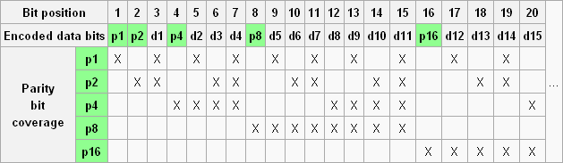
Hamming Codes (1950 Paper)‏

Slide 34
Bit position of the data and parity bits
2
6
4
010
110
100
7
3
111
5
011
101
1
001

Slide 35
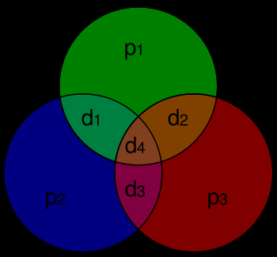
Graphical depiction of the 4 data bits and 3 parity bits and which parity bits apply to which data bits

Slide 36
Error Detection and Correction
1 2 3 4 5 6 7
P1 = D1 XOR D2 XOR D4
P2 = D1 XOR D3 XOR D4
P4 = D2 XOR D3 XOR D4
p₁
p₂
D₁
p₄
D₂
D₃
D₅
p₁
p₂
D₁
p₃
D₂
D₃
D₄
p₁
p₂
D₁
p₄
D₂
D₃
D₄
p₁
p₂
D₁
p₃
D₂
D₃
D₄

Slide 37
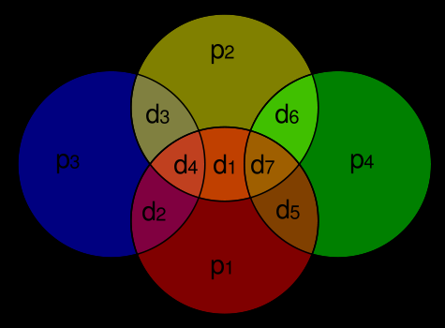
Graphical depiction of the 7 data bits and 4 parity bits and which parity bits apply to which data bits

Slide 38
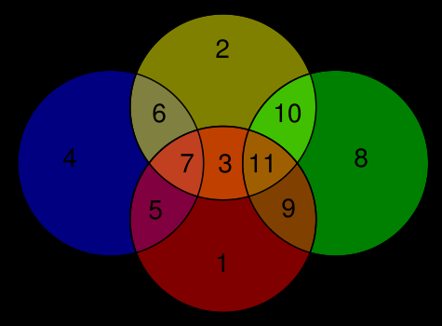
Bit position of the data and parity bits

Slide 39
Example of (11,7)‏
7-bit data word "0110101“
Data word with parity “10001100101”
If last bit of data word flip “10001100100”
Checking of parity bit
Correction of Error “10001100101”
7-bit data word "0110101“

Slide 40
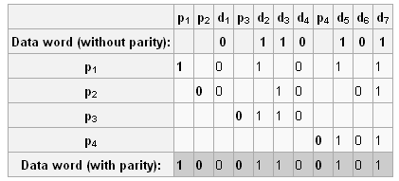
Calculation of Hamming code parity bits

Slide 41
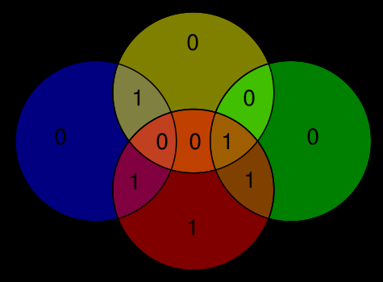
Hamming(11,7) code 7-bit data word "0110101"

Slide 42
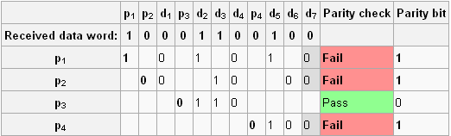
Checking of parity bits (switched bit highlighted)

Slide 43

Checking of parity bits (switched bit highlighted)

Slide 44

Correction of Error

